Slide 1
Evaluation
Chris Manning and Pandu Nayak
CS276 – Information Retrieval and Web Search

Slide 2
Situation
Thanks to your stellar performance in CS276, you quickly rise to VP of Search at internet retail giant nozama.com. Your boss brings in her nephew Sergey, who claims to have built a better search engine for nozama. Do you
Laugh derisively and send him to rival Tramlaw Labs?
Counsel Sergey to go to Stanford and take CS276?
Try a few queries on his engine and say “Not bad”?
… ?

Slide 3
What could you ask Sergey?
Sec. 8.6
How fast does it index?
Number of documents/hour
Incremental indexing – nozama adds 10K products/day
How fast does it search?
Latency and CPU needs for nozama’s 5 million products
Does it recommend related products?
This is all good, but it says nothing about the quality of Sergey’s search
You want nozama’s users to be happy with the search experience

Slide 4
How do you tell if users are happy?
Search returns products relevant to users
How do you assess this at scale?
Search results get clicked a lot
Misleading titles/summaries can cause users to click
Users buy after using the search engine
Or, users spend a lot of $ after using the search engine
Repeat visitors/buyers
Do users leave soon after searching?
Do they come back within a week/month/… ?

Slide 5

Happiness: elusive to measure
Sec. 8.1
Most common proxy: relevance of search results
Pioneered by Cyril Cleverdon in the Cranfield Experiments
But how do you measure relevance?

Slide 6
Measuring relevance
Sec. 8.1
Three elements:
A benchmark document collection
A benchmark suite of queries
An assessment of either Relevant or Nonrelevant for each query and each document

Slide 7
So you want to measure the quality of a new search algorithm?
Benchmark documents – nozama’s products
Benchmark query suite – more on this
Judgments of document relevance for each query
5 million nozama.com products
Relevance
judgment
50000
sample
queries

Slide 8
Relevance judgments
Binary (relevant vs. non-relevant) in the simplest case
More nuanced relevance levels also used(0, 1, 2, 3 …)
What are some issues already?
5 million times 50K takes us into the range of a quarter trillion judgments
If each judgment took a human 2.5 seconds, we’d still need 10¹¹ seconds, or nearly $300 million if you pay people $10 per hour to assess
10K new products per day

Slide 9
Crowd source relevance judgments?
Present query-document pairs to low-cost labor on online crowd-sourcing platforms
Hope that this is cheaper than hiring qualified assessors
Lots of literature on using crowd-sourcing for such tasks
You get fairly good signal, but the variance in the resulting judgments is quite high

Slide 10
What else?
Sec. 8.5
Still need test queries
Must be germane to docs available
Must be representative of actual user needs
Random query terms from the documents are not a good idea
Sample from query logs if available
Classically (non-Web)
Low query rates – not enough query logs
Experts hand-craft “user needs”

Slide 11
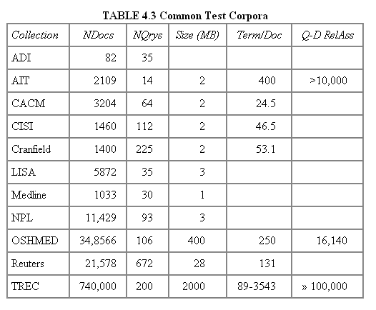
Early public test Collections (20th C)
Sec. 8.5
Typical TREC
Recent datasets: 100s of million web pages (GOV, ClueWeb, …)

Slide 12
Now we have the basics of a benchmark
Let’s review some evaluation measures
Precision
Recall
DCG
…

Slide 13
Evaluating an IR system
Sec. 8.1
Note: user need is translated into a query
Relevance is assessed relative to the user need, not the query
E.g., Information need: My swimming pool bottom is becoming black and needs to be cleaned.
Query: pool cleaner
Assess whether the doc addresses the underlying need, not whether it has these words

Slide 14
Unranked retrieval evaluation: Precision and Recall – recap from IIR 8/video
Sec. 8.3
Binary assessments
Precision: fraction of retrieved docs that are relevant = P(relevant|retrieved)
Recall: fraction of relevant docs that are retrieved
= P(retrieved|relevant)
Precision P = tp/(tp + fp)
Recall R = tp/(tp + fn)
 | Relevant | Nonrelevant
Retrieved | tp | fp
Not Retrieved | fn | tn

Slide 15
Rank-Based Measures
Binary relevance
Precision@K (P@K)
Mean Average Precision (MAP)
Mean Reciprocal Rank (MRR)
Multiple levels of relevance
Normalized Discounted Cumulative Gain (NDCG)

Slide 16

Precision@K
Set a rank threshold K
Compute % relevant in top K
Ignores documents ranked lower than K
Ex:
Prec@3 of 2/3
Prec@4 of 2/4
Prec@5 of 3/5
In similar fashion we have Recall@K

Slide 17
A precision-recall curve
Sec. 8.4
Lots more detail on this in the
Canvas video

Slide 18

Mean Average Precision
Consider rank position of each relevant doc
K₁, K₂, … K_{R}
Compute Precision@K for each K₁, K₂, … K_{R}
Average precision = average of P@K
Ex: has AvgPrec of
MAP is Average Precision across multiple queries/rankings

Slide 19
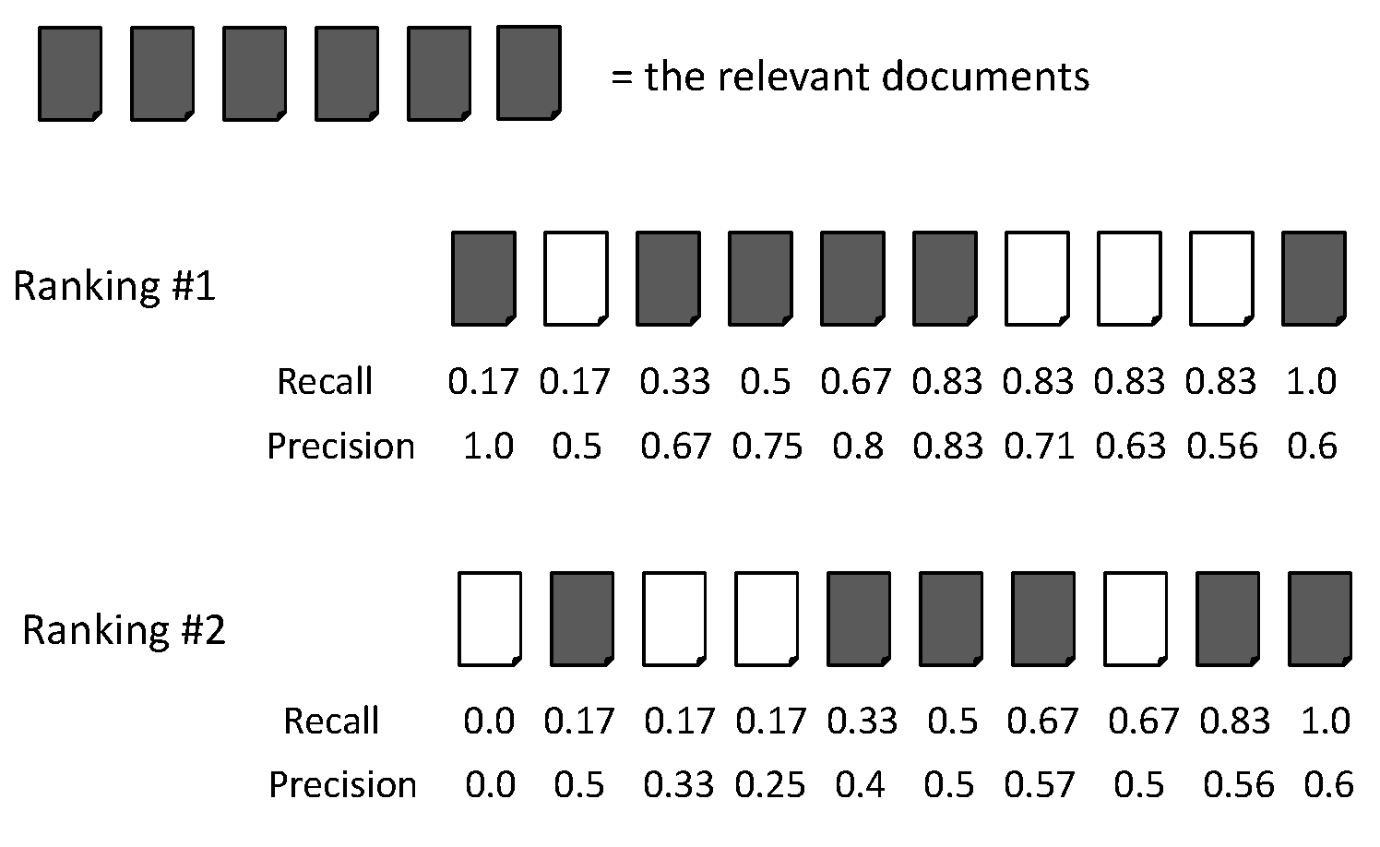
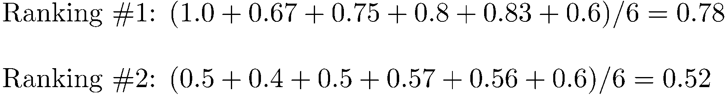
Average Precision

Slide 20
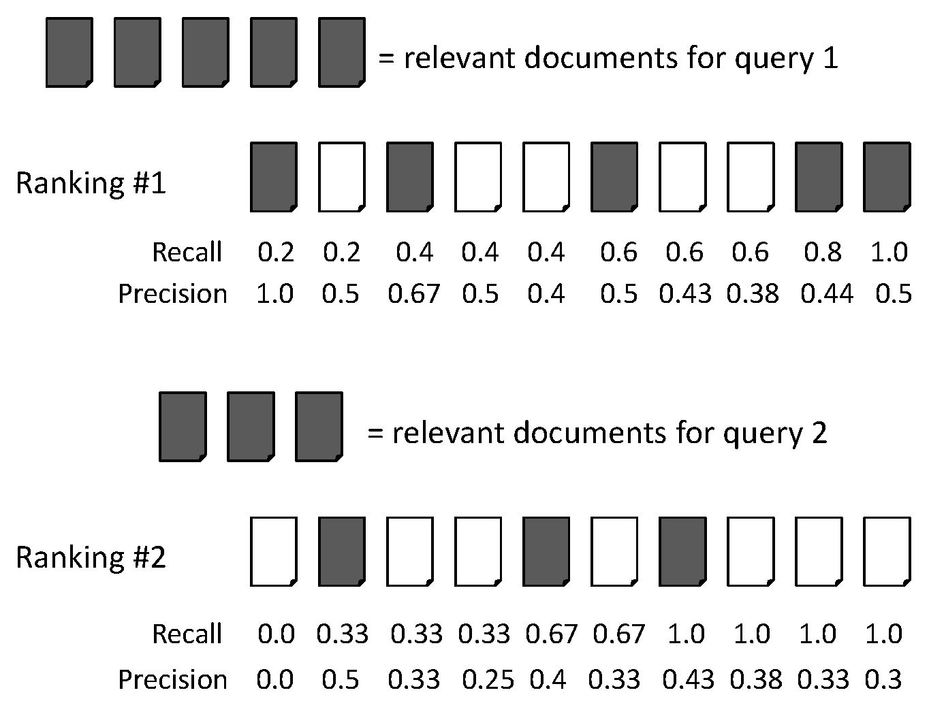
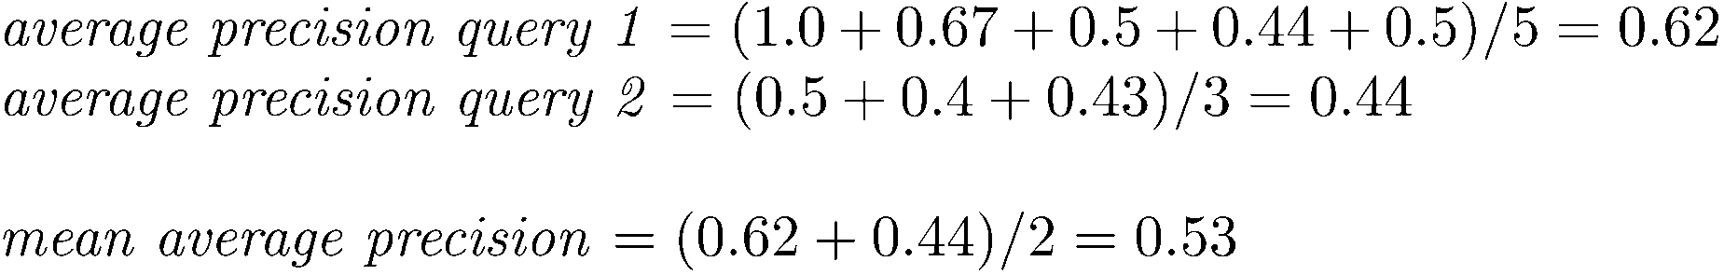
MAP

Slide 21
Mean average precision
If a relevant document never gets retrieved, we assume the precision corresponding to that relevant doc to be zero
MAP is macro-averaging: each query counts equally
Now perhaps most commonly used measure in research papers
Good for web search?
MAP assumes user is interested in finding many relevant documents for each query
MAP requires many relevance judgments in text collection

Slide 22
Beyond binary relevance

Slide 23
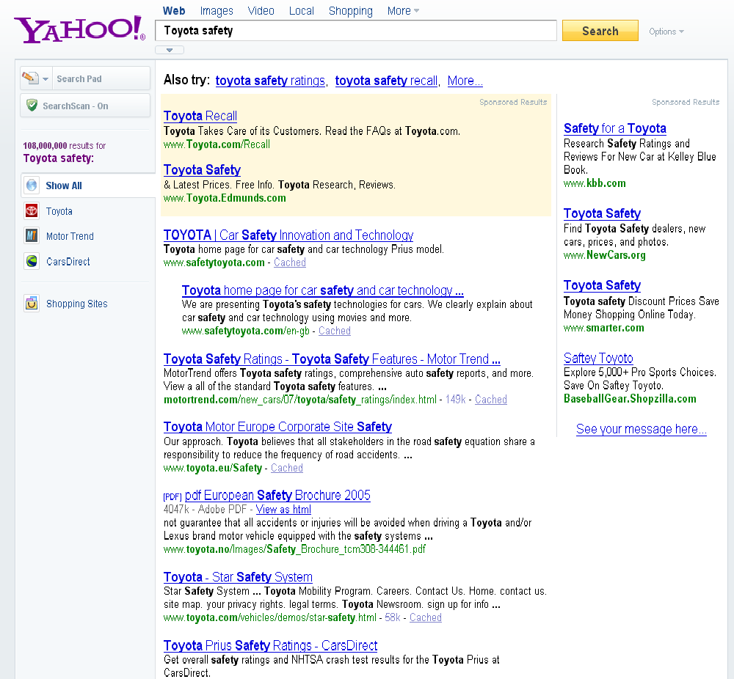
fair
fair
Good

Slide 24
Discounted Cumulative Gain
Popular measure for evaluating web search and related tasks
Two assumptions:
Highly relevant documents are more useful than marginally relevant documents
the lower the ranked position of a relevant document, the less useful it is for the user, since it is less likely to be examined

Slide 25
Discounted Cumulative Gain
Uses graded relevance as a measure of usefulness, or gain, from examining a document
Gain is accumulated starting at the top of the ranking and may be reduced, or discounted, at lower ranks
Typical discount is 1/log (rank)
With base 2, the discount at rank 4 is 1/2, and at rank 8 it is 1/3

Slide 26
Summarize a Ranking: DCG
What if relevance judgments are in a scale of [0,r]? r>2
Cumulative Gain (CG) at rank n
Let the ratings of the n documents be r₁, r₂, …r_{n} (in ranked order)
CG = r₁+r₂+…r_{n}
Discounted Cumulative Gain (DCG) at rank n
DCG = r₁ + r₂/log₂2 + r₃/log₂3 + … r_{n}/log₂n
We may use any base for the logarithm
Notes:
For rank positions above b, do not discount

Slide 27
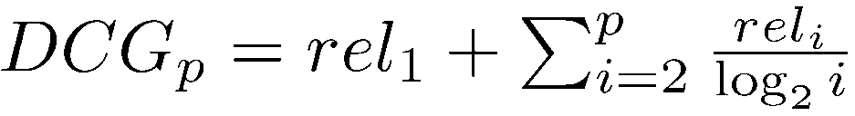
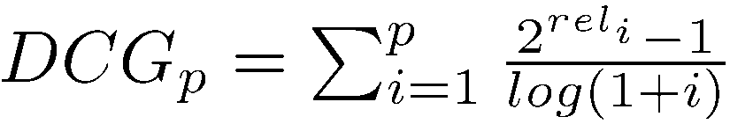
Discounted Cumulative Gain
DCG is the total gain accumulated at a particular rank p:
Alternative formulation:
used by some web search companies
emphasis on retrieving highly relevant documents

Slide 28
DCG Example
10 ranked documents judged on 0–3 relevance scale:
3, 2, 3, 0, 0, 1, 2, 2, 3, 0
discounted gain:
3, 2/1, 3/1.59, 0, 0, 1/2.59, 2/2.81, 2/3, 3/3.17, 0
= 3, 2, 1.89, 0, 0, 0.39, 0.71, 0.67, 0.95, 0
DCG:
3, 5, 6.89, 6.89, 6.89, 7.28, 7.99, 8.66, 9.61, 9.61
Notes:
Normalized DCG:
DCG values are often normalized by comparing the DCG at each rank with the DCG value for the perfect ranking
makes averaging easier for queries with different numbers of relevant documents

Slide 29
NDCG for summarizing rankings
Normalized Discounted Cumulative Gain (NDCG) at rank n
Normalize DCG at rank n by the DCG value at rank n of the ideal ranking
The ideal ranking would first return the documents with the highest relevance level, then the next highest relevance level, etc
Normalization useful for contrasting queries with varying numbers of relevant results
NDCG is now quite popular in evaluating Web search
Notes:
Perfect ranking:
3, 3, 3, 2, 2, 2, 1, 0, 0, 0
ideal DCG values:
3, 6, 7.89, 8.89, 9.75, 10.52, 10.88, 10.88, 10.88, 10
Actual DCG:
3, 5, 6.89, 6.89, 6.89, 7.28, 7.99, 8.66, 9.61, 9.61
NDCG values (divide actual by ideal):
1, 0.83, 0.87, 0.76, 0.71, 0.69, 0.73, 0.8, 0.88, 0.88
NDCG ≤ 1 at any rank position

Slide 30
NDCG - Example
4 documents: d₁, d₂, d₃, d₄
i | Ground Truth |  | Ranking Function₁ |  | Ranking Function₂
 | Document Order | r_{i} | Document Order | r_{i} | Document Order | r_{i}
1 | d4 | 2 | d3 | 2 | d3 | 2
2 | d3 | 2 | d4 | 2 | d2 | 1
3 | d2 | 1 | d2 | 1 | d4 | 2
4 | d1 | 0 | d1 | 0 | d1 | 0
 | NDCG_{GT}=1.00 |  | NDCG_{RF1}=1.00 |  | NDCG_{RF2}=0.9203

Slide 31
What if the results are not in a list?
Suppose there’s only one Relevant Document
Scenarios:
known-item search
navigational queries
looking for a fact
Search duration ~ Rank of the answer
measures a user’s effort

Slide 32
Mean Reciprocal Rank
Consider rank position, K, of first relevant doc
Could be – only clicked doc
Reciprocal Rank score =
MRR is the mean RR across multiple queries

Slide 33
Human judgments are
Expensive
Inconsistent
Between raters
Over time
Decay in value as documents/query mix evolves
Not always representative of “real users”
Rating vis-à-vis query, don’t know underlying need
May not understand meaning of terms, etc.
So – what alternatives do we have?

Slide 34
Using user Clicks

Slide 35
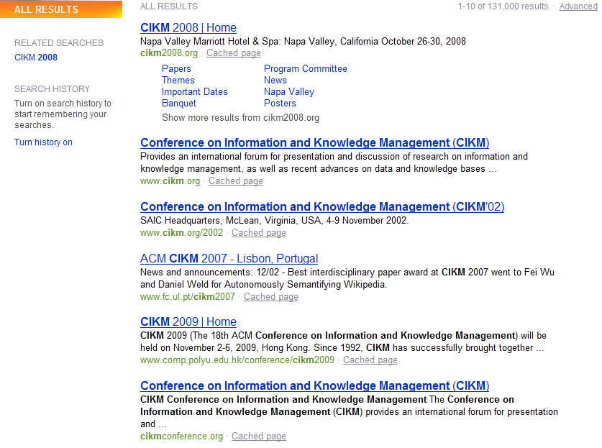
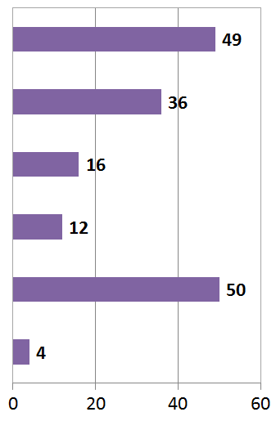
User Behavior
Taken with slight adaptation from Fan Guo and Chao Liu’s 2009/2010 CIKM tutorial: Statistical Models for Web Search: Click Log Analysis
Search Results for “CIKM” (in 2009!)
# of clicks received

Slide 36
User Behavior
Adapt ranking to user clicks?
# of clicks received

Slide 37
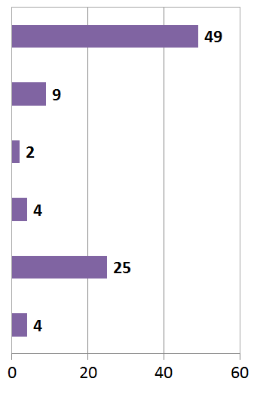

What do clicks tell us?
Tools needed for non-trivial cases
# of clicks received
Strong position bias, so absolute click rates unreliable

Slide 38
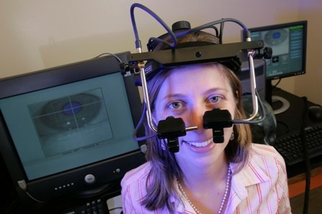
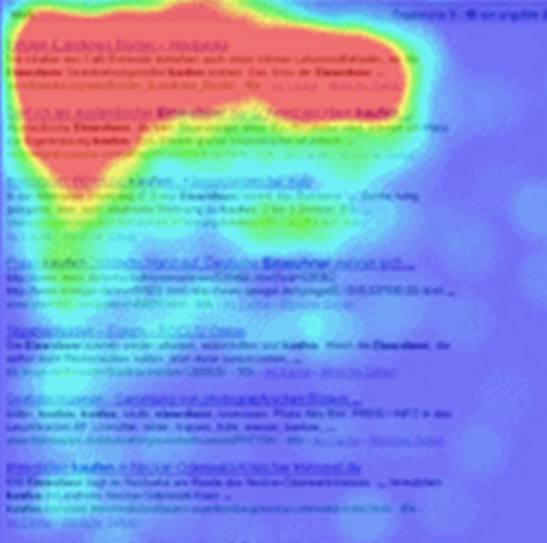
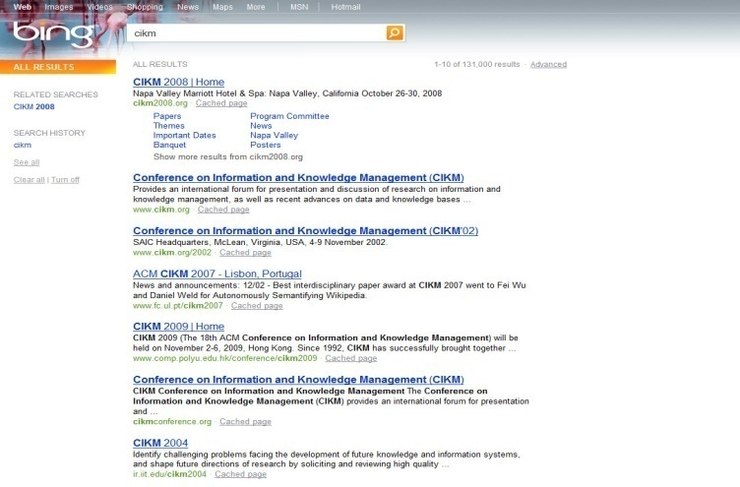
Eye-tracking User Study
Notes:
MENTION MORE CLEARLY THAT THIS SUPPORTS THE IDEA OF RANKING UP AN ITEM THAT IS CLICKED AND BELOW AN ITEM THAT ISN”T CLICKED.

Slide 39
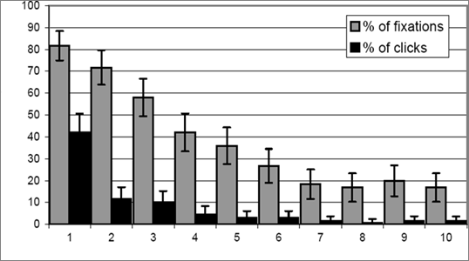
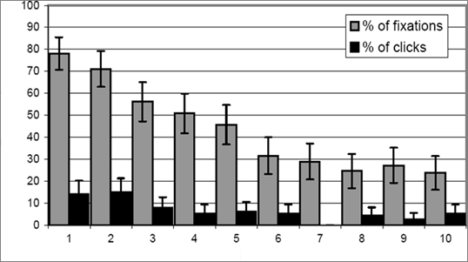
Click Position-bias
Higher positions receive more user attention (eye fixation) and clicks than lower positions.
This is true even in the extreme setting where the order of positions is reversed.
“Clicks are informative but biased”.
Percentage
Normal Position
Percentage
Reversed Impression
[Joachims+07]

Slide 40
Relative vs absolute ratings
User’s click
sequence
Hard to conclude Result1 > Result3
Probably can conclude Result3 > Result2

Slide 41
Evaluating pairwise relative ratings
Pairs of the form: DocA better than DocB for a query
Doesn’t mean that DocA relevant to query
Now, rather than assess a rank-ordering wrt per-doc relevance assessments …
Assess in terms of conformance with historical pairwise preferences recorded from user clicks
BUT!
Don’t learn and test on the same ranking algorithm
I.e., if you learn historical clicks from nozama and compare Sergey vs nozama on this history …

Slide 42
Comparing two rankings via clicks (Joachims 2002)
Query: [support vector machines]
Ranking A
Ranking B
Kernel machines
Kernel machines
SVM-light
SVMs
Lucent SVM demo
Intro to SVMs
Royal Holl. SVM
Archives of SVM
SVM software
SVM-light
SVM tutorial
SVM software

Slide 43
Interleave the two rankings
Kernel machines
Kernel machines
SVMs
This interleaving starts with B
SVM-light
Intro to SVMs
Lucent SVM demo
Archives of SVM
Royal Holl. SVM
SVM-light
…

Slide 44
Remove duplicate results
Kernel machines
Kernel machines
SVMs
SVM-light
Intro to SVMs
Lucent SVM demo
Archives of SVM
Royal Holl. SVM
SVM-light
…

Slide 45
Count user clicks
Kernel machines
A, B
Kernel machines
Clicks
SVMs
Ranking A: 3 Ranking B: 1
SVM-light
A
Intro to SVMs
Lucent SVM demo
A
Archives of SVM
Royal Holl. SVM
SVM-light
…

Slide 46
Interleaved ranking
Present interleaved ranking to users
Start randomly with ranking A or ranking B to even out presentation bias
Count clicks on results from A versus results from B
Better ranking will (on average) get more clicks

Slide 47
A/B testing at web search engines
Sec. 8.6.3
Purpose: Test a single innovation
Prerequisite: You have a large search engine up and running.
Have most users use old system
Divert a small proportion of traffic (e.g., 0.1%) to an experiment to evaluate an innovation
Interleaved experiment
Full page experiment

Slide 48
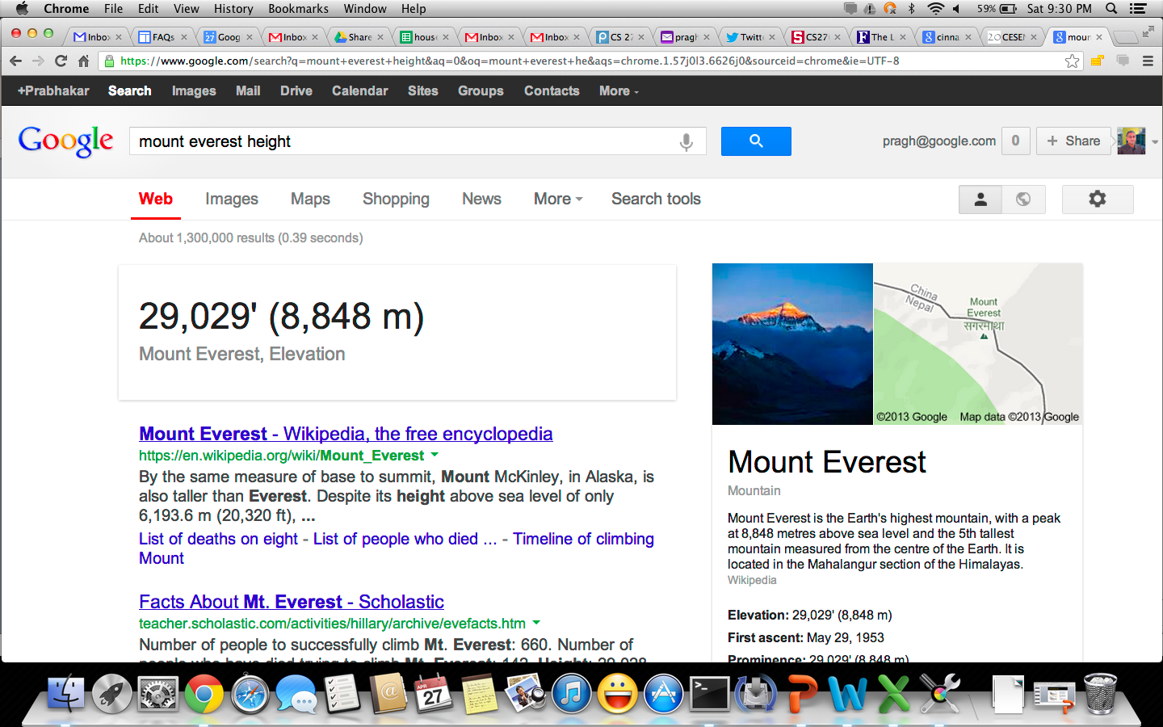
Facts/entities (what happens to clicks?)

Slide 49
Recap
Benchmarks consist of
Document collection
Query set
Assessment methodology
Assessment methodology can use raters, user clicks, or a combination
These get quantized into a goodness measure – Precision/NDCG etc.
Different engines/algorithms compared on a benchmark together with a goodness measure

Slide 50
User behavior
User behavior is an intriguing source of relevance data
Users make (somewhat) informed choices when they interact with search engines
Potentially a lot of data available in search logs
But there are significant caveats
User behavior data can be very noisy
Interpreting user behavior can be tricky
Spam can be a significant problem
Not all queries will have user behavior

Slide 51
Incorporating user behavior into ranking algorithm
Incorporate user behavior features into a ranking function like BM25F
But requires an understanding of user behavior features so that appropriate V_{j} functions are used
Incorporate user behavior features into learned ranking function
Either of these ways of incorporating user behavior signals improve ranking

Slide 52
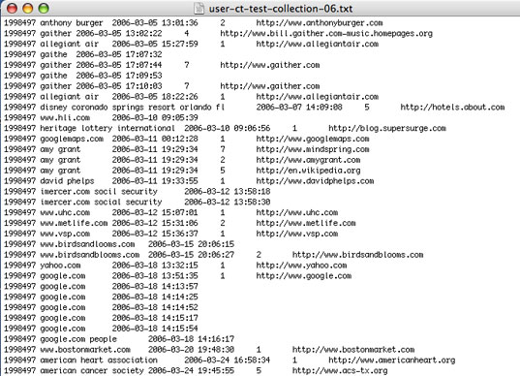
Web search click log
An example

Slide 53

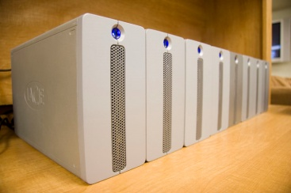
Web Search Click Log
How large is the click log?
search logs: 10+ TB/day
In existing publications:
[Silverstein+99]: 285M sessions
[Craswell+08]: 108k sessions
[Dupret+08] : 4.5M sessions (21 subsets * 216k sessions)
[Guo +09a] : 8.8M sessions from 110k unique queries
[Guo+09b]: 8.8M sessions from 110k unique queries
[Chapelle+09]: 58M sessions from 682k unique queries
[Liu+09a]: 0.26PB data from 103M unique queries

Slide 54
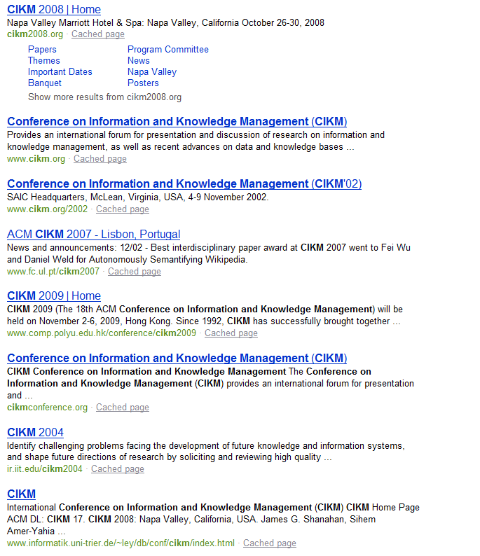


Interpret Clicks: an Example
Clicks are good…
Are these two clicks equally “good”?
Non-clicks may have excuses:
Not relevant
Not examined

Slide 55
Resources
S. E. Robertson and H. Zaragoza. 2009. The Probabilistic Relevance Framework: BM25 and Beyond. Foundations and Trends in Information Retrieval 3(4): 333-389.
K. Spärck Jones, S. Walker, and S. E. Robertson. 2000. A probabilistic model of information retrieval: Development and comparative experiments. Part 1. Information Processing and Management 779–808.
T. Joachims. Optimizing Search Engines using Clickthrough Data. 2002. SIGKDD.
E. Agichtein, E. Brill, S. Dumais. 2006. Improving Web Search Ranking By Incorporating User Behavior Information. 2006. SIGIR.

Slide 56
Features based on user behavior
From [Agichtein, Brill, Dumais 2006; Joachims 2002]
Click-through features
Click frequency, click probability, click deviation
Click on next result? previous result? above? below>?
Browsing features
Cumulative and average time on page, on domain, on URL prefix; deviation from average times
Browse path features
Query-text features
Query overlap with title, snippet, URL, domain, next query
Query length

Slide 57
Comparing two rankings to a baseline ranking
Given a set of pairwise preferences P
We want to measure two rankings A and B
Define a proximity measure between A and P
And likewise, between B and P
Want to declare the ranking with better proximity to be the winner
Proximity measure should reward agreements with P and penalize disagreements

Slide 58
Kendall tau distance
Let X be the number of agreements between a ranking (say A) and P
Let Y be the number of disagreements
Then the Kendall tau distance between A and P is
(X-Y)/(X+Y)
Say P = {(1,2), (1,3), (1,4), (2,3), (2,4), (3,4))} and A=(1,3,2,4)
Then X=5, Y=1 …
(What are the minimum and maximum possible values of the Kendall tau distance?)

